Slide 1

Ethical Practices-Research & Evaluation
Week 10 Synchronous Session

Slide 2
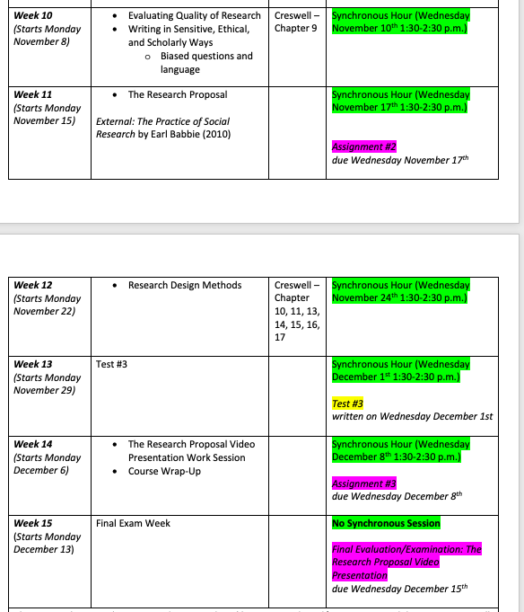
Attention:
Changes to Course
Plan

Slide 3

Survey Instrument Design
When writing good survey questions, researchers typically follow the following steps:
They write different types of questions

Slide 4


Survey Questions - The 7 Different Types

Slide 5
The 7 Types of Survey Questions
Personal
Behavioural
Attitudinal
Sensitive
Closed-Ended
Open-Ended
Semi-Closed

Slide 6
Survey Instrument Design
When writing good survey questions, researchers typically follow the following steps:
They write different types of questions
They use strategies for good question construction

Slide 7
Question Construction
Good questions are clear and do not confuse participant
Using good questions help participants feel that they understand the question and can provide meaningful answers.
They show respect to participants by being sensitive to gender, class, ability and needs
When you construct questions, fit the questions to the answers, include suitable response options, and do not overlap (can be confusing to respondents)

Slide 8
Survey Instrument Design
When writing good survey questions, researchers typically follow the following steps:
They write different types of questions
They use strategies for good question construction
They perform a pilot test of the questions

Slide 9

Pilot Testing Your Survey Questions

Slide 10

Testing The Questions
Helps to identify if all individuals can complete the survey and understand the questions
Participants typically include written comments directly on the survey, and the researcher modifies or changes the survey to reflect those concerns

Slide 11

Remember: Upcoming Due Dates
Assignment #2- The Survey/Questionnaire- Due Wednesday November 17th by 11:59 p.m.
Test #3- Wednesday December 1st
Covers Weeks 9-12

